Slide 1
Docker Networks

Slide 2
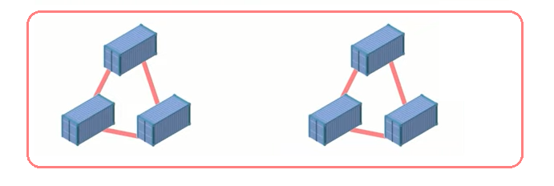
Docker Network
A Docker network is basically a connection between one or more containers. One of the more powerful things about the Docker containers is that they can be easily connected to one other and even other software, this makes it very easy to isolate and manage the containers.

Slide 3
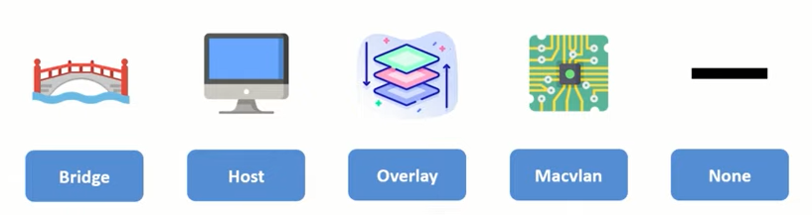
Types of Docker Networks

Slide 4
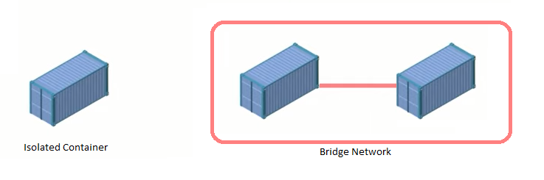
1. Bridge Network
In terms of Docker, a bridge network uses a software bridge which allows containers connected to the same bridge network to communicate, while providing isolation from containers which are not connected to that bridge network.
Bridge networks apply to containers running on the same Docker daemon host. For communication among containers running on different Docker daemon hosts, you can either manage routing at the OS level, or you can use an overlay network.
When you start Docker, a default bridge network (also called bridge) is created automatically, and newly-started containers connect to it unless otherwise specified. You can also create user-defined custom bridge networks. User-defined bridge networks are superior to the default bridge network.

Slide 5
1. Bridge Network.
Create Docker Network.
~ sudo docker network create –-driver <driver_name> <network_name>
~ sudo docker network create –-driver bridge barbie
List Docker Network.
~ sudo docker network ls
Inspect Docker Network.
~ sudo docker network inspect <network_id>
Run Docker with Network flag.
~ sudo docker run –it –d –-name MyCon –-network barbie ubuntu

Slide 6
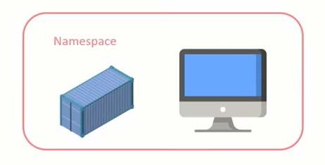
2. Host Network
If you use the host network mode for a container, that container’s network stack is not isolated from the Docker host (the container shares the host’s networking namespace), and the container does not get its own IP-address allocated. For instance, if you run a container which binds to port 80 and you use host networking, the container’s application is available on port 80 on the host’s IP address.
The host networking driver only works on Linux hosts, and is not supported on Docker Desktop for Mac, Docker Desktop for Windows, or Docker EE for Windows Server.

Slide 7
2. Host Network.
List Docker Network.
~ sudo docker network ls
Inspect Docker Network.
~ sudo docker network inspect <network_id>
Run Docker with Network flag.
~ sudo docker run –it –d –-name MyCon –-network host ubuntu

Slide 8
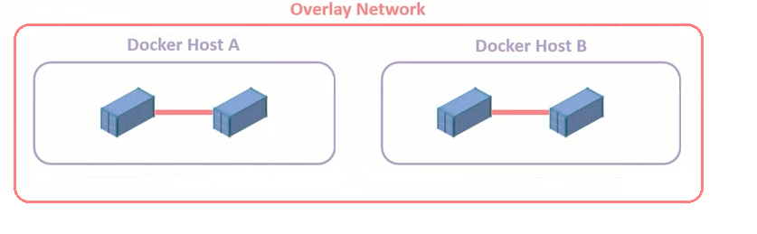
3. Overlay Network
Docker daemon hosts that are connected by the means of an overlay network can communicate with each other. This means that containers present in different docker hosts can communicate with each other using the overlay network.
This is useful when we need a set of docker hosts to communicate with each other in a docker swarm.

Slide 9
3. Overlay Network.
Create Overlay Network.
~ sudo docker network create –-driver overlay fun-net
Create Service.
~ sudo docker service create –-name fun-service –-network fun-net
-–replicas 3 nginx
List containers running in this service.
~ sudo docker service ps fun-service

Slide 10
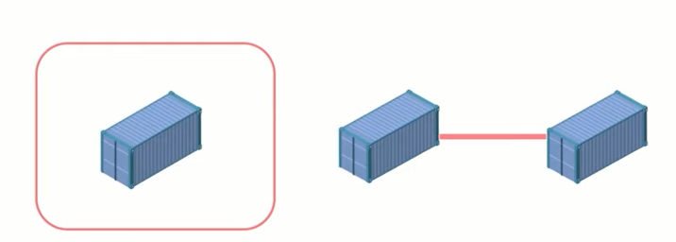
4. None Network
A Docker container which has none network configured for itself cannot communicate with any service or system as networking for the container is virtually disabled.
Its usually used to isolate certain containers.

Slide 11
4. None Network.
Run container in None Network.
~ sudo docker run –it –d –-name nonCon –-network none ubuntu
~ sudo docker container inspect nonCon

Slide 12
5. Macvlan Network
Some applications, especially legacy applications or applications which monitor network traffic, expect to be directly connected to the physical network. In this type of situation, you can use the macvlan network driver to assign a MAC address to each container’s virtual network interface, making it appear to be a physical network interface directly connected to the physical network. In this case, you need to designate a physical interface on your Docker host to use for the macvlan, as well as the subnet and gateway of the macvlan. You can even isolate your macvlan networks using different physical network interfaces
Create macvlan Network.
When you create a macvlan network, it can either be in bridge mode or 802.1q trunk bridge mode.
In bridge mode, macvlan traffic goes through a physical device on the host.
In 802.1q trunk bridge mode, traffic goes through an 802.1q sub-interface which Docker creates on the fly. This allows you to control routing and filtering at a more granular level.

Slide 13
Macvlan Bridge Mode
To create a macvlan network which bridges with a given physical network interface, use --driver macvlan with the docker network create command. You also need to specify the parent, which is the interface the traffic will physically go through on the Docker host.
~ docker network create -d macvlan \
--subnet=172.16.86.0/24 \
--gateway=172.16.86.1 \
-o parent=eth0 pub_net
If you need to exclude IP addresses from being used in the macvlan network, such as when a given IP address is already in use, use --aux-addresses:
~ docker network create -d macvlan \
--subnet=192.168.32.0/24 \
--ip-range=192.168.32.128/25 \
--gateway=192.168.32.254 \
--aux-address="my-router=192.168.32.129" \
-o parent=eth0 macnet32

Slide 14
Macvlan 802.1q trunk Bridge Mode
If you specify a parent interface name with a dot included, such as eth0.50, Docker interprets that as a sub-interface of eth0 and creates the sub-interface automatically.
~ docker network create -d macvlan \
--subnet=192.168.50.0/24 \
--gateway=192.168.50.1 \
-o parent=eth0.50 macvlan50

Slide 15
Thank You !

